Slide 1
Course
AWS Cloud Practitioner
MaxCloud

Slide 2
02
Class
AWS IAM
Amazon EC2
Amazon EBS

Slide 3
AWS EC2
Amazon EC2 provides on-demand, scalable computing capacity in the Amazon Web Services (AWS) Cloud.
You can use Amazon EC2 to launch as many or as few virtual servers as you need
You can add capacity (scale up) to handle compute-heavy tasks, such as monthly or yearly processes, or spikes in website traffic.

Slide 4
Features I
Instances: Virtual Servers
Amazon Machine Images: Preconfigured templates for your instances that package the components you need for your server
Instance types: Various configurations of CPU, memory, storage, networking capacity, and graphics hardware for your instances.
Key pairs: Secure login information for your instances. AWS stores the public key and you store the private key in a secure place.

Slide 5
Features II
Instance store volumes: Storage volumes for temporary data that is deleted when you stop, hibernate, or terminate your instance.
Amazon EBS volumes: Persistent storage volumes for your data using Amazon Elastic Block Store (Amazon EBS).
Security groups: A virtual firewall that allows you to specify the protocols, ports, and source IP ranges that can reach your instances, and the destination IP ranges to which your instances can connect.
Tags: Metadata that you can create and assign to your Amazon EC2 resources.

Slide 6
EC2 key Pairs
A key pair, consisting of a public key and a private key, is a set of security credentials that you use to prove your identity when connecting to an Amazon EC2 instance.
Amazon EC2 stores the public key on your instance, and you store the private key.
Anyone who possesses your private key can connect to your instances, so it's important that you store your private key in a secure place.

Slide 7
Amazon Machine Image (AMI)
An Amazon Machine Image (AMI) is a supported and maintained image provided by AWS that provides the information required to launch an instance.
You must specify an AMI when you launch an instance.
You can launch multiple instances from a single AMI when you require multiple instances with the same configuration.

Slide 8
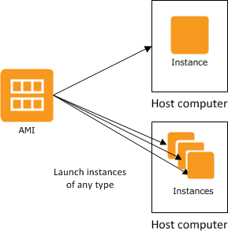
Amazon Machine Image (AMI)

Slide 9
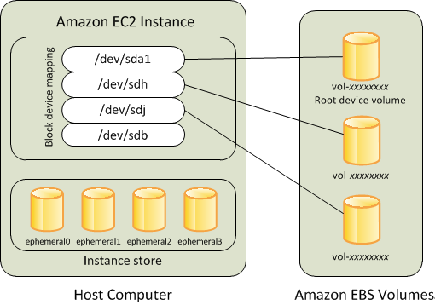
Amazon EC2 Instance Store vs Amazon EBS

Slide 10
Lab
Run EC2 instance

Slide 11
EC2 User data scripts
#!/bin/bash
yum update -y
amazon-linux-extras install -y lamp-mariadb10.2-php7.2 php7.2
yum install -y httpd mariadb-server
systemctl start httpd
systemctl enable httpd
usermod -a -G apache ec2-user
chown -R ec2-user:apache /var/www
chmod 2775 /var/www
find /var/www -type d -exec chmod 2775 {} \;
find /var/www -type f -exec chmod 0664 {} \;
echo "<?php phpinfo(); ?>" > /var/www/html/phpinfo.php

Slide 12
Metadata
Instance metadata is data about your instance that you can use to configure or manage the running instance.
Metadata is divided into categories, for example, host name, events, and security groups.

Slide 13
EC2 Instance Types
General purpose
Compute optimized
Memory optimized
Accelerate computing
Storage optimized
HPC optimized

Slide 14
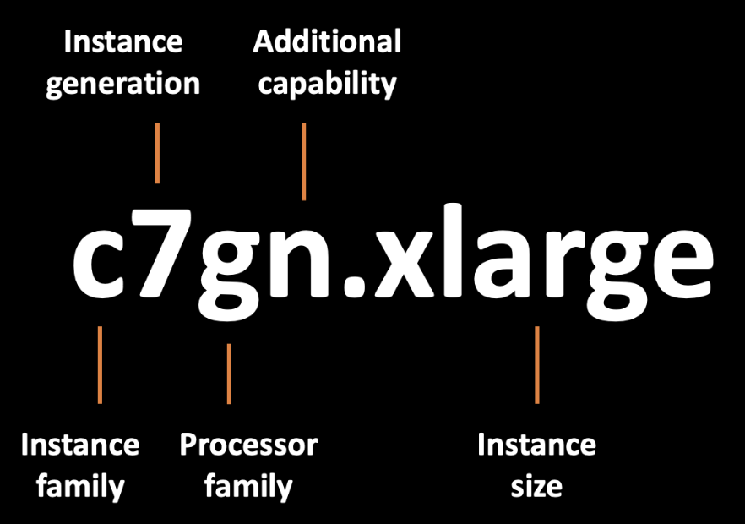
Instance type naming convention

Slide 15
Instance purchasing options
On-Demand Intances
Reserved Instances
Spot Instances
Dedicated Instances
Dedicated Hosts
Saving Plans

Slide 16
EC2 Security Groups
A security group acts as a virtual firewall for your EC2 instances to control incoming and outgoing traffic.
Inbound rules control the incoming traffic to your instance, and outbound rules control the outgoing traffic from your instance.
When you launch an instance, you can specify one or more security groups.
If you don't specify a security group, Amazon EC2 uses the default security group for the VPC.
You can add rules to each security group that allow traffic to or from its associated instances

Slide 17



EC2 Security Groups
Security Group
Allow
Deny
Allow
Instance

Slide 18
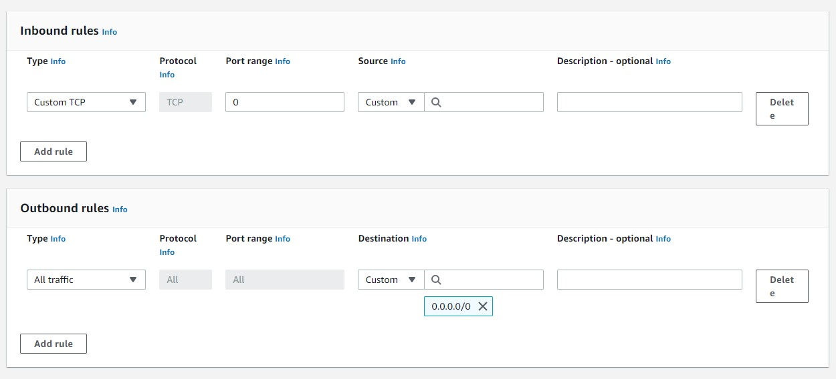
EC2 Security Groups

Slide 19
Principal ports
Ports 20 and 21: File Transfer Protocol (FTP).
Port 22: Secure Shell (SSH).
Port 80: Hypertext Transfer Protocol (HTTP).
Port 443: HTTP Secure (HTTPS).
Port 5432: default PostgreSQL port.

Slide 20
Muchas Gracias

